Slide 1
Application of Virtual Reality in Experimental Economics
Aaska Shah, Kerala Brendon, Nolan Slade, Vyome Kishore
Supervised by Dr Stephanie Thomas & Dr Jacques Carette

Slide 2


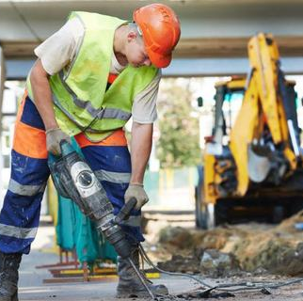
Duncan’s Dilemma
Chronic hip pain has impacted his ability to earn a living as a construction worker
His condition could be significantly improved through surgery
Ontario: 6 to 8 month wait time for a free operation
USA: costs $30 000, but could be done in a week
What should Duncan do?
Notes:
Duncan is a middle-aged construction worker in rural Ontario, who is in dire need of a hip replacement. He has a family to support, and he’s struggling to get through each day on the job. His pain is having a direct impact on his ability to earn a living, and he’s decided that it’s time to get the surgery he needs.
In rural Ontario, it’s possible he could be waiting as long as 8 months to receive surgery; but, at least he wouldn’t have to pay for it out of pocket.
Another option on the table is to drive down to the states and pay a sizeable amount of cash in order to receive the surgery almost right away.
How would Duncan arrive at his final decision? It effectively comes down to a simple question, but one that’s quite difficult to answer: what dollar figure is Duncan’s health worth?

Slide 3
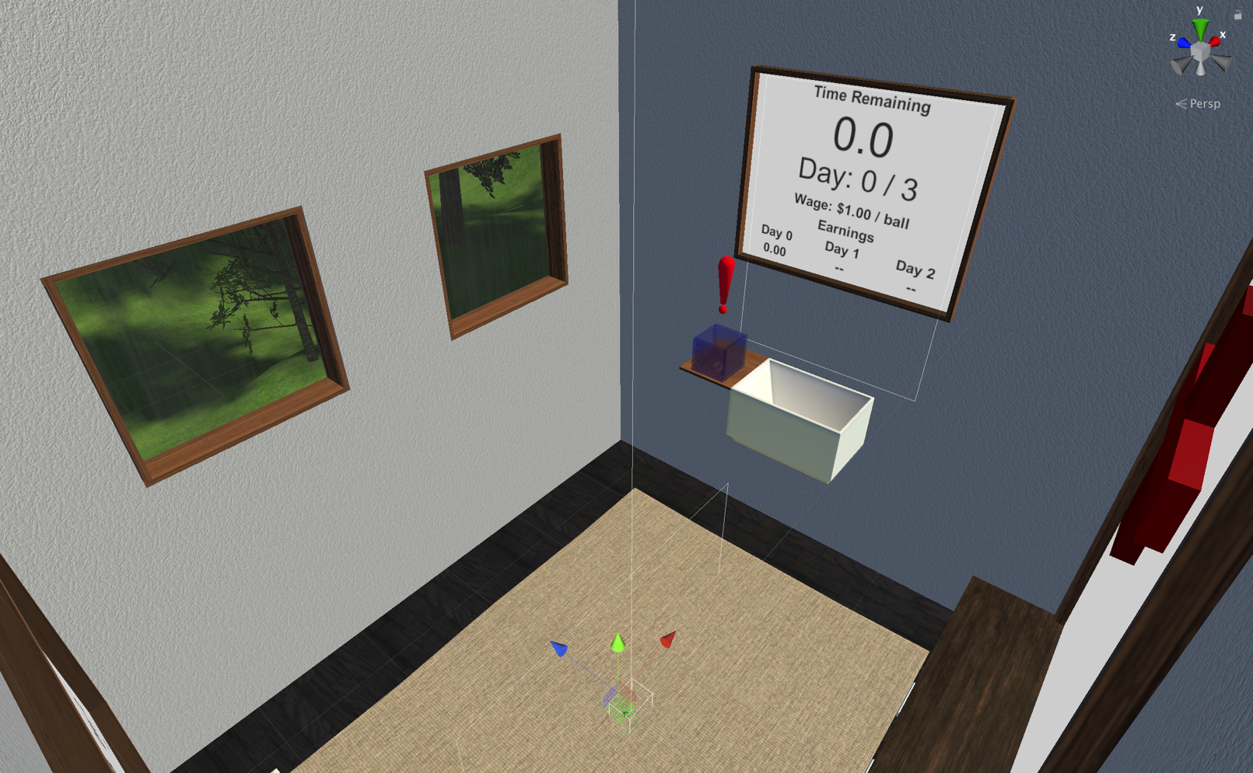
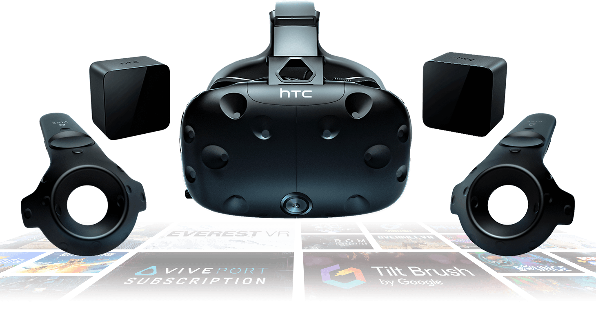

Our Contribution: SteamVR with Unity
Notes:
Our contribution to the project aimed to bring the participant into a much more immersive environment by using virtual reality. Using the lab’s HTC Vive equipment in conjunction with the Unity game engine and SteamVR, we were able to design a fully interactive and highly configurable application that the lab will be able to use for years to come to carry out their research experiments.
Using SteamVR, we track the participant’s headset and controller positions in the physical world, and translate those into the virtual world. Rather than using the commonplace teleport mechanism to move throughout the virtual world, we actually make the participant walk – the scene is measured to be almost identical to the physical room in the McDSL, with a slight buffer zone so that nobody runs into or touches the walls during the experiment.

Slide 4
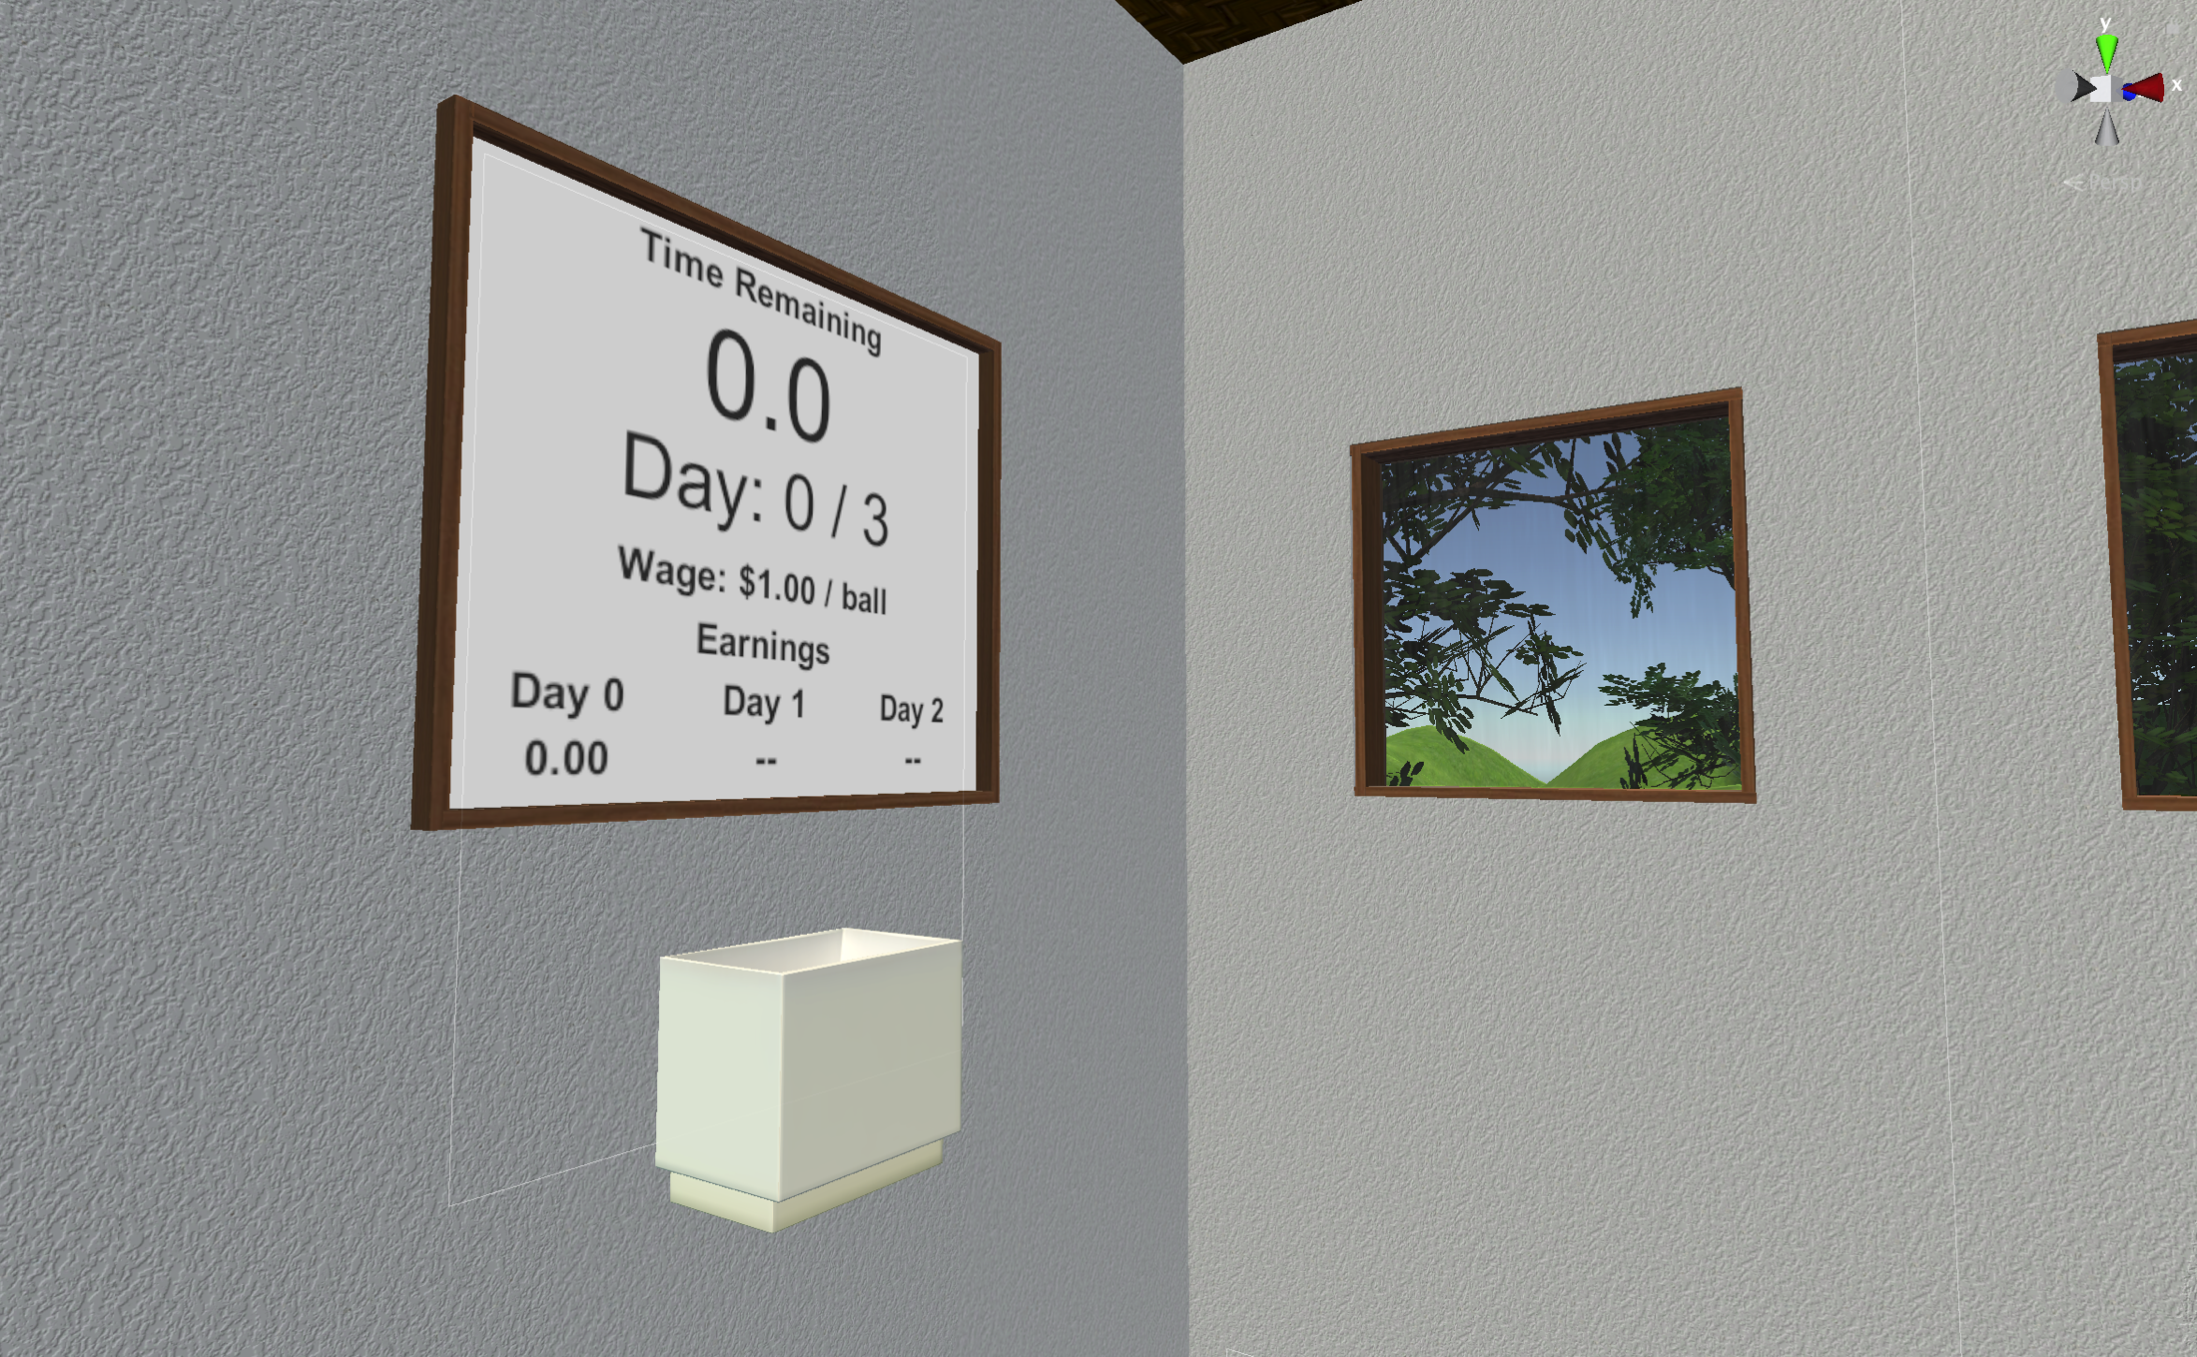
The Effort Task
PHOTO OF THEM HOLDING BUCKET + FILLING FROM PIPE HERE
The participant’s goal:
Maximize income from transporting balls
Notes:
The effort-based task implemented in our application is simple: use a container to transport bouncy balls from one side of the room to the other. On one side of the room, there is an outlet pipe that dispenses balls into the participant’s bucket; on the other side, there’s a tub that they are instructed to pour the balls into.
The participant is payed some dollar amount for every ball they successfully deliver. The effort component of this task is defined by both how fast they’re able to carry out this task; that is, balls delivered per unit time, and also their spill ratio, which is essentially how careful they are being. In short, a participant with high skill exerting great effort will have a low spill ratio, and a high delivery rate.

